Slide 1


Forecasting AirBnb prices in Geneva

Slide 2
The context and the problem
Airbnb is a popular website to offer short time accomodation to customers
A municipality might want to know the situaiton in its city to better understand if Airbnb is going well or not in its territory and what are the main factors affecting the revenues for such service
Some renter might also want to have insights on how to improve the revenues from its rented properties
The problem:
In the project we foreacast prices and annual revenues of homes and appartments in Geneva, Switzerland, using data from
http://insideairbnb.com/get-the-data.html
Foursquare API
Geopy

Slide 3
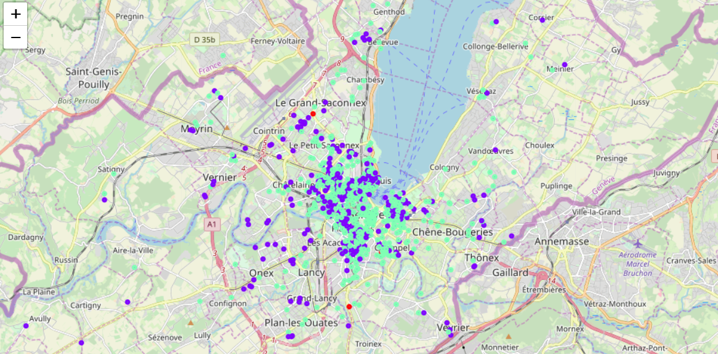
The solution
A random Forest Regressor is traned on a sample to predict the revenues for a given house the accuracy is computed as the MSE of 0.99
The most important parameter is found to be the number of reviews an apartment has got.
Using neighborhoods caracteristics to reinforce the lerning has no effect. This might be to the fact that Geneva is a relatively small city with lot os similarities in its territory.
Municipalities and renters can have a better look at the scenario of AirBnb thanks to this work and might try to understand if their property can get more value from AirBnb or from other renting strategies.
Patrizio Canzi

